Slide 1
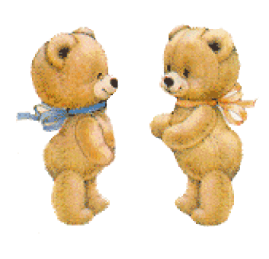
Polly Dale “Little bears”

Slide 2
Once two little brown bears

Slide 3
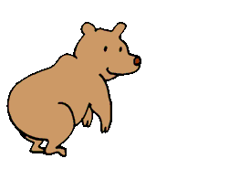
Found a pear tree full of pears:

Slide 4
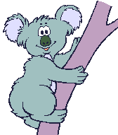
But they couldn’t climb up there For the trunk was smooth and bare.

Slide 5
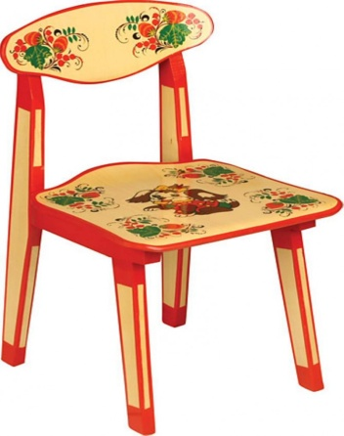
“If I only had a chair,- Said the elder brown bear-

Slide 6
I would get the biggest pear That is hanging in the air”

Slide 7
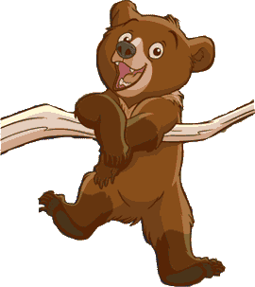
“If you don’t soil my hear,- Said the younger little bear-

Slide 8
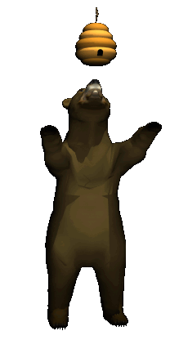
I will serve you as a chair And you can get the biggest pear”.

